Slide 1
AI Game Course
Project Name: Frozen Lake
Area: AI + Game
Group ID: G7
Members: Xinglin Yu, Joshua Chen, Xing Fan, Qinyun Song,
Chaoqun Zhao, Mol Sun, Robin Liu, Zhiyu Tian
Presenter: Joshua Chen, Xinglin Yu
2022 / 09 / 09

Slide 2
Overview
Policy Visualization Tool
Policy
a=pi(s)
Test
Experimental Success Rate
Env analysis
4 RL Algorithm
Test
Theoretical Success Rate
Preparation
Train
Test

Slide 3
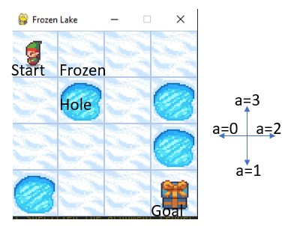
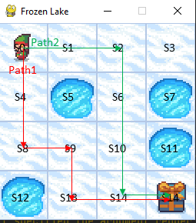
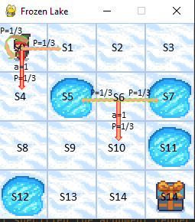
Preparation
(a) State & Action
(b) 2 Paths
(c) Action and Slippery
Action Space: Discrete(4)
Observation Space: Discrete(16)
Target: Crossing a frozen lake from Start(S) to Goal(G) without falling into any Holes(H) by walking over the Frozen(F) lake.
Nature: The agent may not always move in the intended direction due to the slippery nature of the frozen lake.
Optimized path: Path1 or Path2?

Slide 4
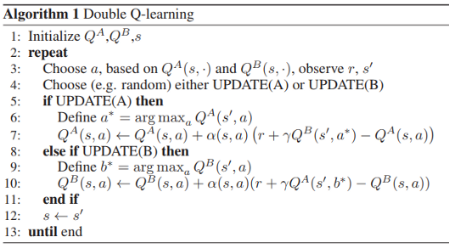
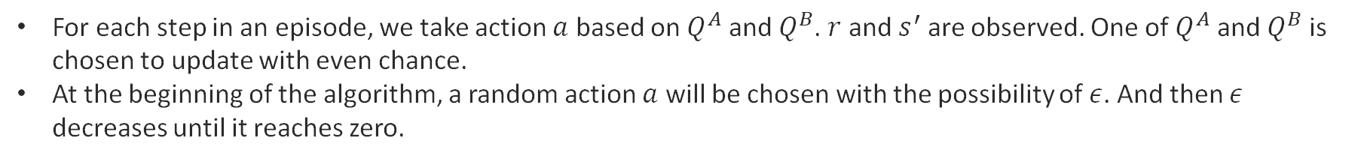
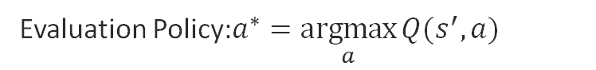
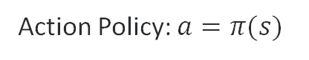
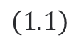
Train
Double Q-Learning
Annealing Algorithm
Off-Policy
$\left(1.1\right)$
Action Policy: $a=π(s)$
Evaluation Policy:$a^{∗}=\underset{a}{argmax}{Q(s^{′}, a)}$
For each step in an episode, we take action $a$ based on $Q^{A}$ and $Q^{B}$. $r$ and $s^{′}$ are observed. One of $Q^{A}$ and $Q^{B}$ is chosen to update with even chance.
At the beginning of the algorithm, a random action $a$ will be chosen with the possibility of $ε$. And then $ε$ decreases until it reaches zero.
Notes:
Q(s, a) 某一时刻的 s状态下, 采取动作a能够获取收益的期望
根据Q值来选取 能够获得最大收益 的动作

Slide 5
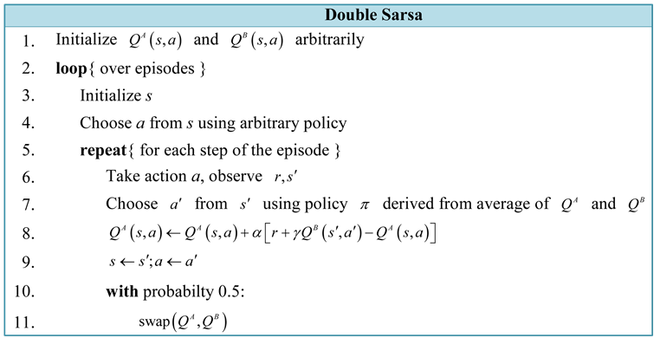
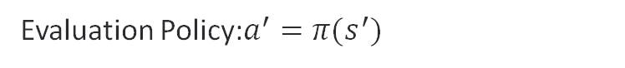
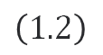
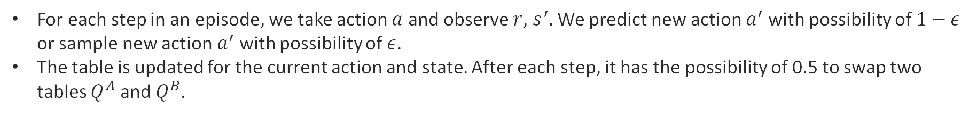
Train
Double – SARSA
Annealing Algorithm
On-Policy
Action Policy: $a=π(s)$
$\left(1.2\right)$
Evaluation Policy:${a^{′}=π(s}^{′})$
For each step in an episode, we take action $a$ and observe $r$, $s^{′}.$ We predict new action $a^{′}$ with possibility of $1−ε$ or sample new action $a^{′}$ with possibility of $ε$.
The table is updated for the current action and state. After each step, it has the possibility of 0.5 to swap two tables $Q^{A}$ and $Q^{B}$.
Notes:
当前时刻 A表状态-动作 值的更新 依赖于 下一时刻 B表的状态-动作值函数

Slide 6
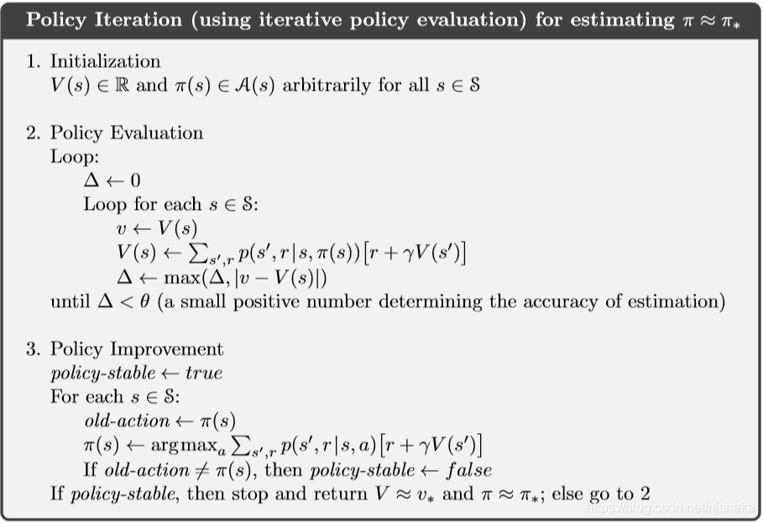
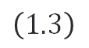
Train
3. Policy Iteration
$\left(1.3\right)$
Action Policy
Value function: V(s) + Policy function: pi(s)
Policy Evaluation: Fixed pi(s) => Update V(s)
Policy Improvement: Multiple iterations => until V(s)->v*, pi->pi*
p(s’, r| s, pi(s)): state transition probability
Notes:
策略评价时, 固定策略函数, 来更新值函数

Slide 7
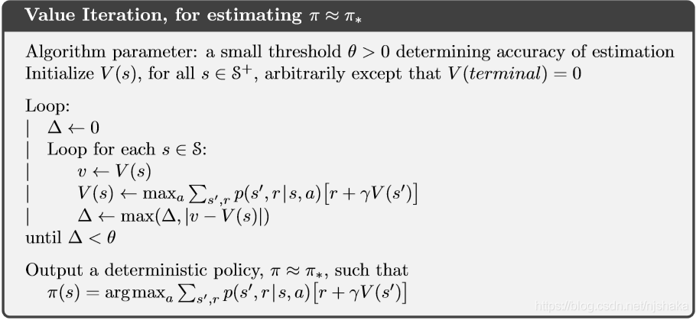
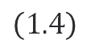
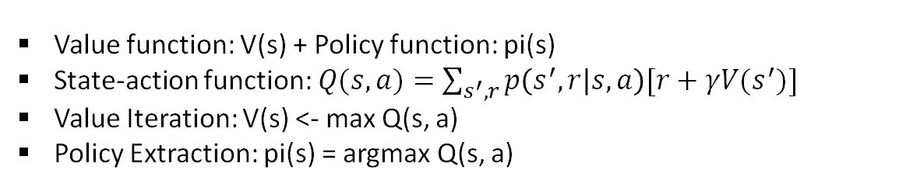
Train
4. Value Iteration
Action Policy
$\left(1.4\right)$
Value function: V(s) + Policy function: pi(s)
State-action function: $Q(s,a)=\sum_{s^{′}, r}{p\left(s^{′},r | s,a\right)[r+γV(s^{′})]}$
Value Iteration: V(s) <- max Q(s, a)
Policy Extraction: pi(s) = argmax Q(s, a)
Notes:
在每个状态s, 会选择使 状态-动作值函数 到达最大的动作, 来更新值函数

Slide 8
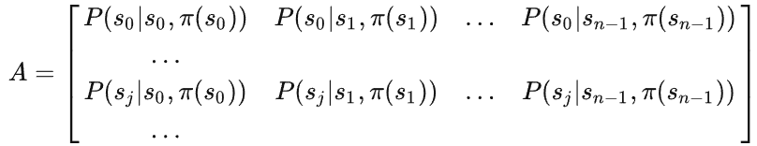

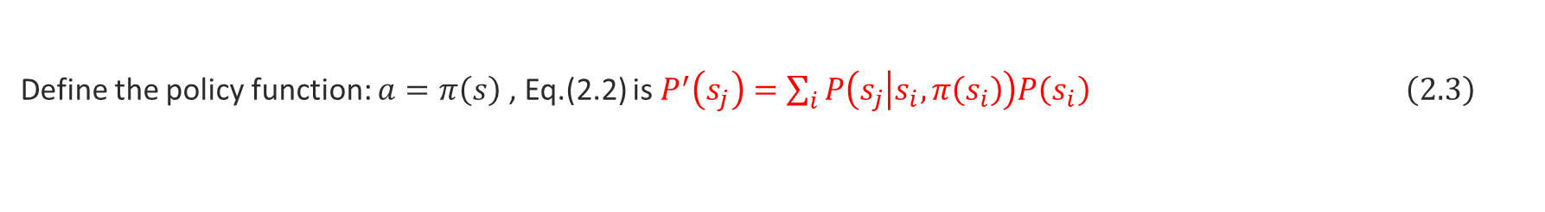
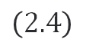
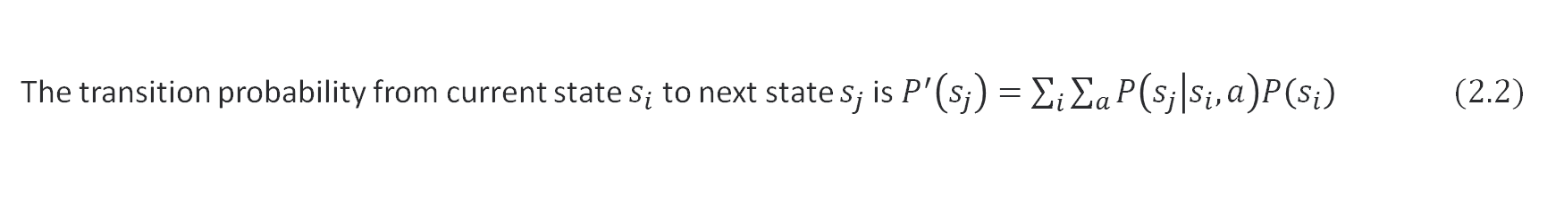
Test
Test Theoretical Success Rate
If within a given policy, what is the Success Rate that the agent will reach the Goal state?
According to the Conditional probabilities: $P\left(A\right)=P\left(A | B\right)×P\left(B\right) \left(2.1\right)$
The transition probability from current state $s_{i}$ to next state $s_{j}$ is $P^{′}\left(s_{j}\right)=\sum_{i}{\sum_{a}{P\left(s_{j} | s_{i},a\right)P\left(s_{i}\right)}} (2.2)$
Define the policy function: $a=π\left(s\right)$ , Eq.(2.2) is $P^{′}\left(s_{j}\right)=\sum_{i}{P\left(s_{j} | s_{i}, π\left(s_{i}\right)\right)P\left(s_{i}\right)} \left(2.3\right)$
Define Transition Probability Matrix as:
$\left(2.4\right)$
Define State Vector: $X=\left[\begin{matrix}P\left(s_{0}\right) & P\left(s_{1}\right) & …\end{matrix} \begin{matrix}P\left(s_{n−2}\right) & P\left(s_{n−1}\right)\end{matrix}\right]$ $\left(2.5\right)$

Slide 9
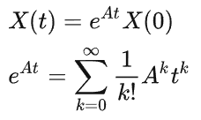
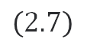
Test
Test Theoretical Success Rate
If within a given policy, what is the Success Rate that the agent will reach the goal state?
The Eq.(2.3) is
$X(t+1)=AX\left(t\right)$ $\left(2.6\right)$
Which has solution
$\left(2.7\right)$
From Eq.(2.6) and Eq.(2.7)
The final Theoretical Success Rate within a policy

Slide 10
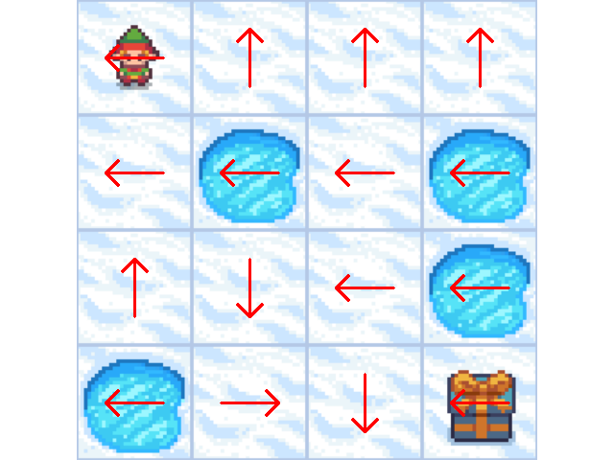
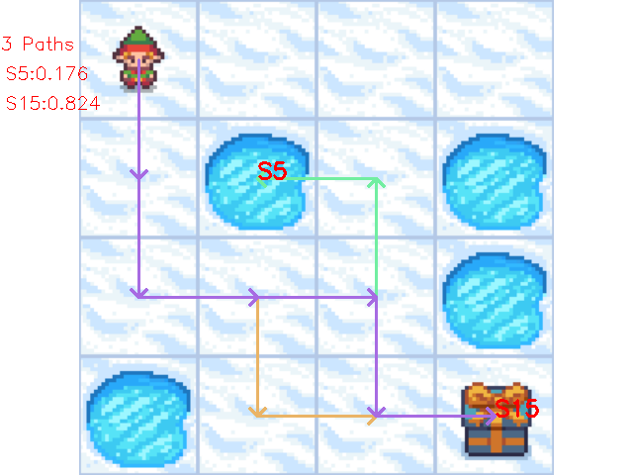
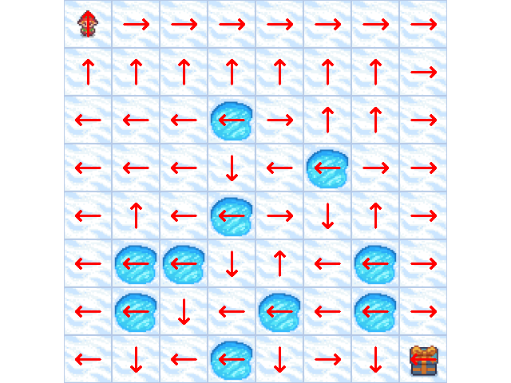
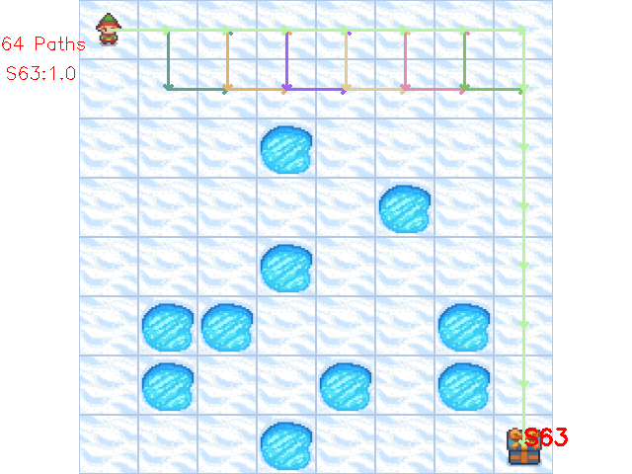
Experiment
Preloaded Maps
a) 4x4 optimized policy
b) 4x4 paths under policy
c) 8x8 optimized policy
d) 8x8 paths under policy

Slide 11
Experiment
Frozen Lake Order | RL Algorithm | Train Convergence Episode | Test Theoretical Success Rate | Test Experimental Success Rate | Test Experimental Episode
4x4 | Policy Iteration | 7 | 82.4% | 82.3% | 10000
 | Value Iteration | 1373 | 82.4% | 82.7% | 10000
 | Double SARSA | 10161 | 82.4% | 82.3% | 10000
 | Double Q-Learnning | 10694 | 82.4% | 82.4% | 10000
8x8 | Policy Iteration | 13 | 100% | 100% | 10000
 | Value Iteration | 2357 | 100% | 100% | 10000
 | Double SARSA | 34979 | 100% | 100% | 10000
 | Double Q-Learnning | 10621 | 100% | 100% | 10000
The policy Iteration has fastest Train Convergence Episodes
All RL Algorithm will tend to same optimized policy and same Test Tehoretical Success Rate

Slide 12
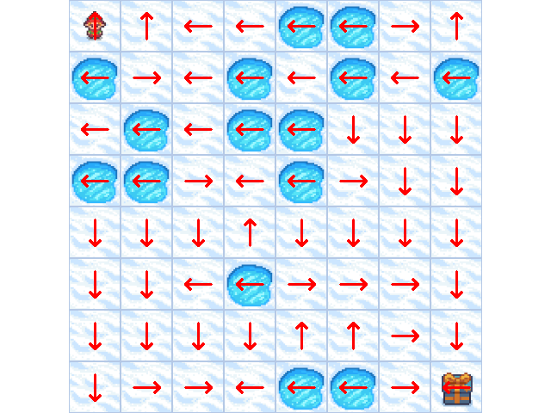
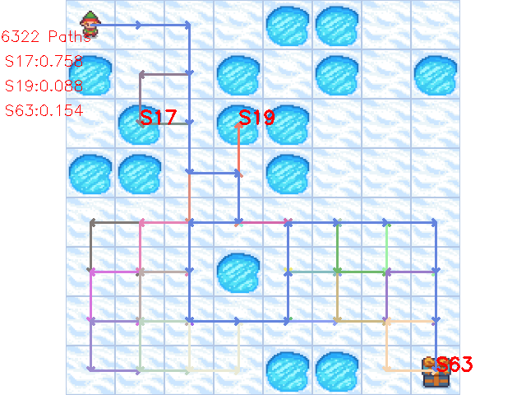
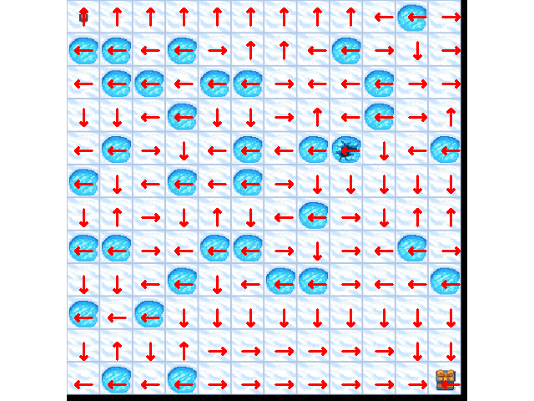
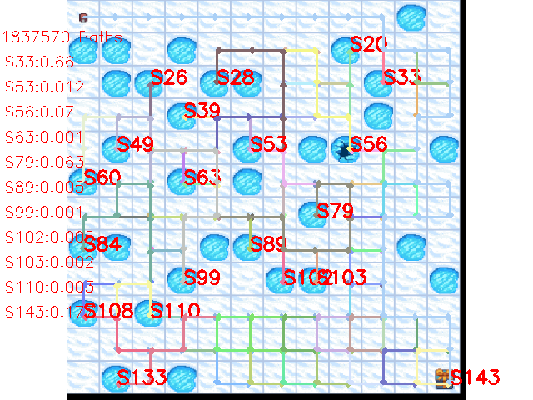
Experiment
Random Maps
a) 8x8 optimized policy of random lake
b) 8x8 paths under policy of random lake
c) 12x12 optimized policy of random lake
d) 12x12 paths under policy of random lake

Slide 13
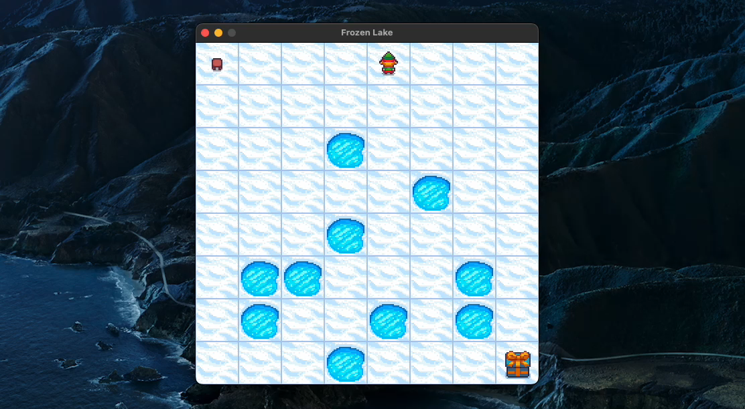
Demo

Slide 14
Summary
1) Increase the max_episode_steps (default 100) can improve the Test Experimental Success Rate
2) Code has been uploaded to Github: xinglin-yu/FrozenLakeFarm (github.com), which includes
- 4 RL algorithm implementation
- Test Theoretical Success Rate Calculation
- Policy Visualization Tool

Slide 15
Refrence
Solving the FrozenLake environment from OpenAI gym using Value Iteration | by Diganta Kalita | Analytics Vidhya | Medium
强化学习实战（一）：用值迭代和策略迭代解决Frozen Lake问题_MADRLer的博客-CSDN博客
Double Sarsa and Double Expected Sarsa with Shallow and Deep Learning (scirp.org)
Double Q-Learning, the Easy Way. Q-learning (Watkins, 1989) is… | by Ziad SALLOUM | Towards Data Science
OpenAI Gym Frozen Lake 冰湖问题详解 - 知乎 (zhihu.com)
Reinforcement Learning: An Introduction

Slide 16
Thanks for watching
AI Course FY22 Team
G7 Group Team
Audiences

